Slide 1
Algorithm Visualisation
Group 79 – Nathan Pitman and David Olsen

Slide 2
Aim
To develop a tool for teaching algorithms, by:
Generating animations from code
Visually displaying important data structures
Animating the flow of data between data structures
Notes:
Our goal was to develop a tool which made it easier to understand algorithms. Typically, lecturers will use some kind of diagram to show an example of the algorithm in action. This might just be a quick sketch on the board, but could also be an animation, or in some cases even a small interactive program.
We have designed a tool to automatically generate an animation from an implementation of an algorithm. The idea is that you write your algorithm and code which uses it as normal, then you run it under our algorithm visualisation tool. Our tool then displays all the supported data structures which are used, and animates values moving around within or between data structures, according to the operations performed on them in the code.

Slide 3
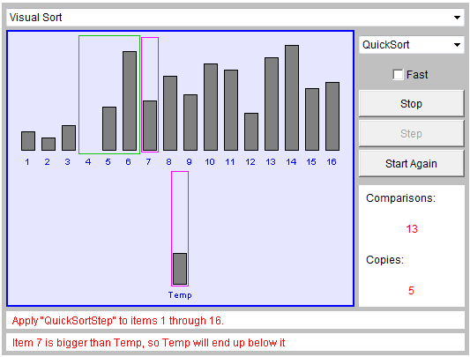
Motivation
From http://wiki.algoviz.org
Existing animation. Useful, but:
Time-consuming to construct
Limited to a few specific sorting algorithms
Notes:
There are a few primary approaches to algorithm visualisation:
One of these is the creation of animated GIFs which are generally used to visually depict sorting algorithms – if you consult Wikipedia regarding any sorting algorithm, chances are that it will utilise several of these as an educational aid.
Another of the primary approaches to algorithm visualisation is the creation of Java applets which are tailored only towards specific algorithms. Furthermore, because they are developed independently using different tools/languages, there is much repeated work between them. Displayed here is an example of one of these applets centered around a few sorting algorithms.
The converse approach taken by debuggers is to display as much of the program state as possible at discrete points in time. This is problematic, as not only does it not emphasize the data which is crucial to comprehending the algorithm at hand, it fails to provide the transitions between program states which animations depict so well.

Slide 4
Requirements
Generic visualisation of algorithms
Minimise required changes to user’s code
To make sensible judgements on which data structures should be displayed
Track data moving between data structures even if through temporary variables which aren’t important enough to be displayed
Notes:
We had a few requirements for our algorithm visualisation framework:
Firstly, our algorithm visualisation framework should not be biased towards any family of algorithms. Essentially, if an algorithm is written which utilises data structures supported by our framework, then we should be able to display it in a meaningful way.
Secondly, to minimise the burden on the person trying to write the algorithm, we wanted to develop a visualisation framework which would work out of the box. In order for a user to have their code automatically visualised, they need simply write it as normal and link against our library. But if the user should desire finer-grained control over the visualisation, they should be able to specify this, either in their code, or through the visualiser’s user interface.
Thirdly, our library should selectively display data structures such that screen space is prudently conserved, users will not be subjected to unnecessary visual overload, and the data structures which are crucial to the user’s understanding of their code are highlighted.
Further, animations to show the transition between states are important in assisting understanding of an algorithm. To show these animations, our system needs to be able to determine where a piece of data to be displayed came from. Not all variables are displayed, so our system needs to track through non-displayed temporary variables to find the source.

Slide 5
System Overview
Data Source
View
Algorithm
VectorWrapper<int>
vector<int>
vector<int> data;
data.push_back(2);
data.push_back(5);
data.insert(data.begin(), 23);
insert 2
2
Notes:
This is an overview of our architecture. In order to perform introspection of data structures which are typically used by C++ programmers, we developed wrappers for these data structures. In our case, introspecting a data structure means knowing the state of it, detecting any operations performed on it, and the parameters of those operations.
Over on the left, we have part of an algorithm which is being written by a user in what appears as standard C++. Invisibly to the user, the standard ‘vector’ and ‘int’ types have actually been redefined as wrapper types (within our data source) which report the insertion operations to the View for animation.
{ elucidate on diagram, mention that vector = dynamic array}

Slide 6
System Overview
Data Source
View
Algorithm
VectorWrapper<int>
vector<int>
vector<int> data;
data.push_back(2);
data.push_back(5);
data.insert(data.begin(), 23);
insert 2
insert 5
2
5

Slide 7
System Overview
Data Source
View
Algorithm
VectorWrapper<int>
vector<int>
vector<int> data;
data.push_back(2);
data.push_back(5);
data.insert(data.begin(), 23);
insert 2
insert 5
copy integer copy integer insert 23
2
5
23
Notes:
When it comes to inserting an integer at the beginning of a vector, it’s a little more complicated, as it involves extra operations such as moving the existing elements to the right. Although our data source detects all of these extra operations, it only reports a single atomic insert operation to the View.
The purpose of the Data Source module is to perform runtime introspection of the data structures used in algorithm code, by any means possible. It reports the data obtained from introspection to the View which animates it. Despite the fact that the View is deployed as a DLL written in C++/QT, by virtue of our flexible architecture, this framework can be used to animate code written in other languages.

Slide 8
Data Source Implementation
C++ Wrappers Solution
Primitives, Matrix, STL types
ID Manager
Problems with the C++ wrapper solution
Notes:
As mentioned earlier, our data source is C++ oriented. It works by redefining each C++ type we want to introspect as our own wrapper type which contains the actual type. Whenever an operation is performed on a wrapper, it is performed on the actual wrapped value, and in addition, the parameters of the operation and any pertinent data are reported to the View. We chose to develop our data-source in C++ as we figured that its power and relatively unconstrained nature would allow us to redefine primitive types such as ‘int’ and ‘char’ as ‘IntWrapper’ and ‘CharWrapper’ respectively, using the #define macro.
Currently, we have wrappers written for the C++ primitive types, a matrix class and STL data structures including the standard vector type and the double-ended queue type. The data source maintains information about every wrapper which is instantiated during execution and allocates each one an ID. This affords a higher level of abstraction than communicating about wrappers based on memory addresses as it allows for cloning behaviour where wrappers can be ‘transplanted’ to new memory addresses yet be treated as the same wrappers by the View. This type of behaviour is desirable as the View mostly isn’t concerned about lower-level implementation details such as elements of a dynamic array taking on new memory addresses when the array is reallocated. The View is only concerned with high-level operations performed upon wrappers, not with any temporary variables created in between which are invisible to the user.
The C++ wrappers solution has worked fairly well thus far, but we have encountered problems with some C++ libraries (such as parts of Boost) which don’t like us redefining primitive types as classes. Aside from that, in accordance with fidelity requirements, our wrappers behave exactly as the types they wrap – they offer the same interface and are identically sized. These library clashes do hamper the use of our framework as a visual debugging tool for C++ as large projects are likely to incorporate external libraries.

Slide 9
Data Source Alternatives
Porting the data source to other languages
Other approaches to data source introspection
Valgrind Tool
Polymorphism
Reflection/Hooking
Notes:
In order for our algorithm visualisation framework to be used to animate code written in another language, a data source has to be developed for that language and it must be equipped to perform introspection on each data-structure which is to be supported. There are many different approaches to code introspection.
We attempted to develop a Valgrind tool which would report low-level information like a debugger. The advantages of this would be that its low level nature would insulate it from special cases like those found in boost, and the user would not need to link against our library when compiling. They would simply need to provide their compiled code with debug information, and our program would handle the rest. However, developing a Valgrind tool is complex and unwieldy, and it would be difficult to reconstruct a high level picture from the data it yields.
Another approach for data source introspection of OOP code is polymorphism/inheritance. That is to say that one can subclass all data structures which should be introspected, override their methods and insert code which reports to the View. This is generally impractical, as primitive types in many languages are PODs (Plain Old Datatypes); they aren’t necessarily modelled as classes.
C++ does not support full runtime structural/behavioural reflection of data, but it could be leveraged for developing data sources in other languages which do support it. Even with reflection, we would still require some hooking mechanism for figuring out when functions are called, to trigger updates to the View. This is often impractical.

Slide 10
View
Data structures are linked to viewable objects
Viewable objects are displayed
Currently string based printable objects
View
Data Source
Viewable Object
Vector
Deque
Array
Printable
Map
Notes:
The view is in charge of displaying data structures. It exposes an interface which presents operations for creating/manipulating/deleting
generic data structures such as array, matrix, printable object and map. Each data structure in the data source corresponds to a viewable object in the view; e.g. vectors and double-ended queues can both be represented in the View as arrays, as they have a lot in common and benefit little from different representation. Any primitive type will be represented as a printable object, since we don’t care what the type really is, as long as we know how to display it. Our array, and any other of our generic data structures, simply contain viewable objects. For those of you familiar with it, this is just the composite design pattern.
Currently our display is purely string based, so printable objects are represented as text strings regardless of their actual type. However, it is extensible, in case future data types are poorly represented by strings. Lecturers typically teach using examples which are easy to write on a board, so for now it is reasonable to simply use text.

Slide 11
View
Actions are animated
Creation/deletion of data structures
Insertion/removal of elements
Update of values
Comparisons
User control of animations
UI Features
Layout
Notes:
The view is also in charge of animating any changes which occur to data structures, which as Nathan mentioned is quite important for clarity. It is notified of these changes by the Datasource, which provides an Action object encapsulating a change. Typical actions would include creation or deletion of a data structure, insertion or removal of elements, and update of the value of an element. Based on this information, the view animates values moving and combining as appropriate. An assignment, for example, would show the value moving from the source element to the destination, and overwriting the current value at the destination.
We also have a comparison action. This action highlights the two values being compared, and displays the comparison operation above the elements. This way you can see when values are compared, but not actually swapped, which makes a sort clearer.
By default our view will perform generic animations which are typically enough to see what is happening. However, there are cases where a user would want to show extra information, or perhaps suppress extraneous information which is getting in the way. There are two ways to approach this. One is to add more user interface functionality to the view, to enable or disable certain animations, or perhaps suppress data structures. While this can be useful, it is somewhat limited and will need to be repeated next time the program is run. Another option is to add hints into the code about which data structures to display and how. This is a little more precise, and our system currently supports this, but not to it’s full potential; only a few settings are available.
The user interface for the view focuses instead on controls for navigating the animation. It allows the user to pause animations, step forward one action at a time and go back in time through previous actions if something was missed. It also allows the user to zoom in/out on objects, label them and drag them around to arrange them in the desired layout. Layout is quite important for more complex algorithms, as screen space is quite limited. The view does support scrolling around a large canvas if not all data structures fit on the screen, but for ease of understanding it is best if everything is in view. With this in mind, our system will attempt to lay out data structures sensibly, placing new data structures close to existing data structures whose data is used in filling the new data structure.

Slide 12
History Manager
Required for pleasing animations
Tracks data through temporaries
For each primitive, maintain the set of values that contributed to its current value
Animate the contributors moving to the destination variable.
8 | 1 | 2 | 9 | 4
1 | 7 | 6 | 7 | 2
Notes:
To animate data moving between data structures, we need to figure out where each piece of data came from. This can be quite complex. Consider an integer. We may take a few integers from one array, add them together, then store them in another array. We don't want to display the temporary values involved, as most of them are unimportant. But for the animation to be clear, we need to show which pieces of data contributed to the new value displayed.
To achieve this, for each integer we maintain the set of displayed integers that were involved in the calculation of its current value. We also keep track of the time that displayed value was read, as the displayed integer may have been updated afterwards, which would mean we couldn't use it in an animation.
So if some temporary integer in a program was assigned a value which was calculated by adding three values in some array displayed on screen, it would have a history set containing those three elements, no matter how many times it was copied since then. If this integer was inserted into some other array, we would animate the three values from the first array moving down, combining, then being placed in the second array. Obviously any other data type would be treated the same way.

Slide 13
Combination
Swaps and similar cause problems
Two or more assignments, but look best as one animation
Can detect these cases by buffering actions
Action Buffer
Algorithm
Time | Action | From (time) | To
1 | Assign | array[0], t₀ | array[1]
2 | Assign | array[1], t₀ | array[0]
int temp = array[1];
array[1] = array[0];
array[0] = temp;
These actions conflict!
Animate them simultaneously.
Notes:
Usually, that sort of animation will look ok, but swapping two values was initially a problem. In the case of a swap, we have three variable assignments. First, item b is assigned to a temporary. Next, item a as assigned to b. Finally, the temporary is assigned to a.
Our program would not display the temporary, as it would clutter the diagram. It would instead show the assignment from a to b first. Then it would use history to track the temporary back to b attempt to show the assignment from b to a, but the history manager would observe that the value of a had changed since it was read. The animation would then be forced to treat the old value of b as an unknown value, and the user could not see that a swap occurred.
To get around this, we implemented a buffer of actions. If an action relies on data that a slightly earlier action overwrites, then these actions are combined, and happen at the same time. By animating a moving to b and b moving to a at the same time we make it obvious a swap has occurred, and the dependency problem is solved in a fairly general way.
We also detect cases where this kind of combination is not possible. If one of the actions depends on the result of another action in the group, combination is not feasible. In theory, it is possible for a group of actions to both require combination due to one data dependency and be infeasible to combine due to another data dependency. In this case our system will choose not to combine, but in our experience such problematic cases are very rare.

Slide 14
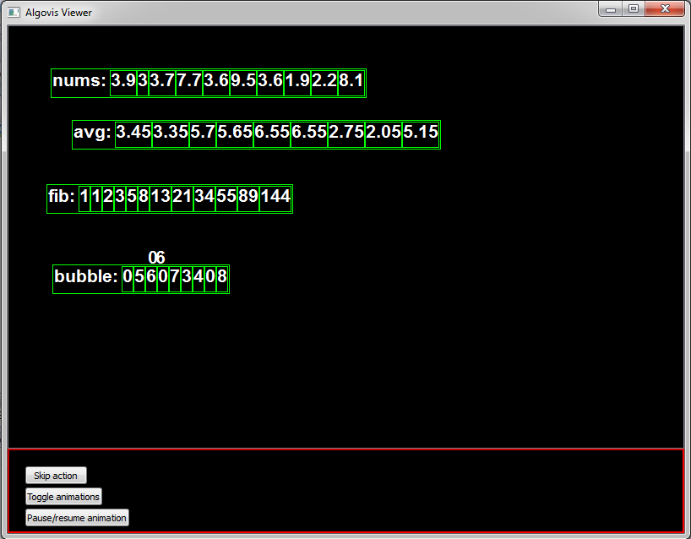
Results
Successful on a variety of simple algorithms
Notes:
We have tested our framework on a few simple algorithms. We have tried it on recursive merge, merge sort, bubble sort and other basic array algorithms including summation, moving average and fibonacci sequence.
A static image does not do it justice, but you can see some of these here.

Slide 15
Future Developments
Improved Datasource
Auto detect names of data structures
Easier to integrate in large projects
Improved usability as a debugger
Refined View
Non-text objects
Statistics Module
Side by side code view
Debugger integration
Notes:
While promising, there are improvements that could be made to the datasource side of the project.
Currently data structures are identified in the view by way of memory address. While we do allow the user to rename them manually, it would be nice if they were listed by variable name by default. This is not possible in C++ due to lack of reflection, but in other languages it would not pose a problem.
It would be possible to develop a datasource which doesn’t suffer from the library clash problems that our C++ datasource faces. Once the system is easier to integrate into large projects, it’s abilities as a visual debugger could be refined.
As mentioned earlier, we could implement the display of elements not represented well by text.
Our animated view is merely one possible view of the data obtained from the datasource. Another option would be a statistics view which provides counts of certain types of operations performed. This could be used to compare the performance characteristics of comparable algorithms. This somewhat less interesting, as it overlaps to a large degree with existing profiling tools.
One very desirable feature would be a code view, showing the current code line updated in sync with the animations. This would provide a concrete link between the code and animation, improving understanding. Unfortunately there is no easy way to do this in C++, but debugger integration would make it possible.
It would be possible, though difficult to integrate existing debuggers into our framework. This would have a number of advantages. It would allow us to gather variable names in languages which do not support reflection. We could also intercept function calls and determine the line of code that called them. The drawback of relying on debug information is that our framework would become not only platform but also compiler specific.

Slide 16
Conclusions
Successful proof of concept
Unprecedented flexibility
Unique dataflow analysis approach
Notes:
The implementation we have currently is capable of animating code which uses: vectors, maps and deques. It is limited in that our Datasource clashes with some existing libraries. It would be possible to port our Datasource to another language which is more suitable to introspection, without affecting the view. This would enable it to be used as a visual debugger.
No other animation tool works for such a wide range of algorithms. The user can write whatever code pops into their head, and our system will animate it in some fashion. In contrast to typical applets which are designed for either a single algorithm or a group of related algorithms. At most, applets allow the user to specify a few parameters.
Our approach to gathering information for the animations is quite unique, as it relies on dataflow information to produce a pleasing animation, rather than showing every single detail as a debugger would, which can be quite tedious.

